Slide 1


SMART EXPENSE TRACKER
(AN AI-DRIVEN BUDGET TRACKER)

Slide 2


INTRODUCTION
OUR PROJECT IS AN AI-POWERED TOOL FOR MANAGING PERSONAL
FINANCES
IT TRACKS AND CATEGORIZES EXPENSES AUTOMATICALLY
WE FOCUSED ON MAKING IT SECURE, EASY TO USE, And based on
core OOP concepts

Slide 3

PROBLEM STATEMENT
TRACKING EXPENSES MANUALLY IS TIME-CONSUMING AND ERROR-PRONE.
ALREADY EXISTING APPS REQUIRE TOO MUCH MANUAL WORK AND LACK GOOD SECURITY.
WE WANTED TO AUTOMATE CATEGORIZATION, MAKE TRACKING EASY, AND ENSURE DATA STAYS SAF

Slide 4
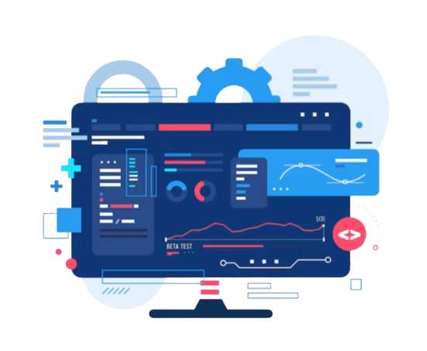
SYSTEM DESIGN COMPONENTS
AUTHENTICATION: SECURE SIGNUP AND LOGIN WITH ENCRYPTION
EXPENSE MANAGER: ADD EXPENSES MANUALLY OR USING AI
AI CATEGORIZATION: AUTO-SORTS EXPENSES THROUGH OPENAI API
REPORTING: GENERATES DETAILED SPENDING REPORTS

Slide 5

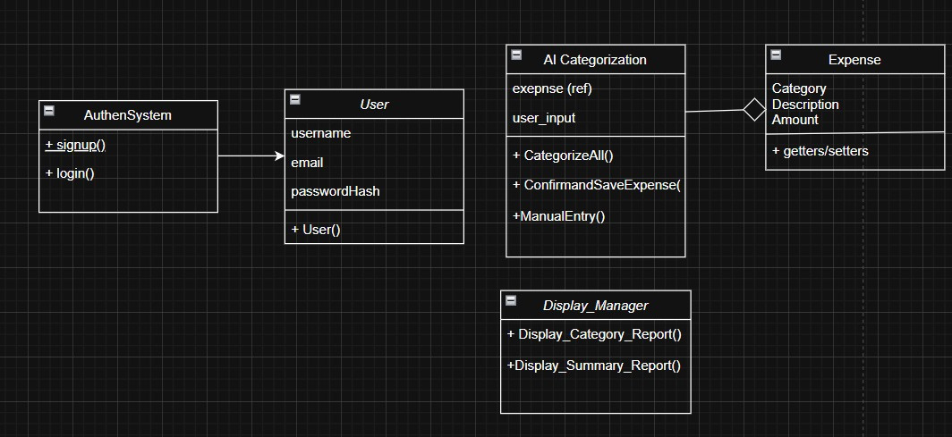
SYSTEM ARCHITECTURE DIAGRAM

Slide 6
TIMELINE
Summarized Expense Reports
AI-Based Expense Categorization
1
3
5
2
4
Secure Login System
Expense Storage & CSV Management
Testing &
Bug Fixes

Slide 7


OOP CONCEPTS APPLIED
ENCAPSULATION: BY KEEPING ATTRIBUTES PRIVATE WITH GETTERS AND SETTERS
ABSTRACTION: THROUGH HIDING ENCRYPTION AND AI LOGIC FROM USERS
MODULAR DESIGN: SEPARATE CLASSES FOR EACH FEATURE
(Inheritance and Polymorphism are planned for future improvements)

Slide 8

KEY FEATURES
SECURE LOGIN WITH SHA-256 AND AES-256 ENCRYPTION.
AI AUTOMATICALLY CATEGORIZES EXPENSES FROM USER INPUT.
OPTION FOR MANUAL EXPENSE ENTRY.
GENERATES BOTH CATEGORY-WISE AND OVERALL SPENDING SUMMARIES.

Slide 9


CHALLENGES FACED
SETTING UP CURL AND OPENSSL LIBRARIES WAS DIFFICULT
DEALING WITH VS CODE ISSUES AND TERMINAL BUGS DURING DEVELOPMENT
HANDLING COMPILER ERRORS WHILE BUILDING THE PROJECT
AI SOMETIMES DIDN’T EXTRACT INFORMATION PROPERLY
MANUAL ENTRY CAUSED ERRORS LIKE WRONG AMOUNTS OR SAVING DUPLICATES

Slide 10
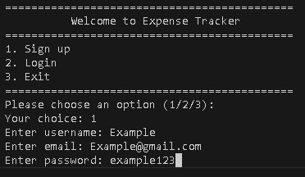
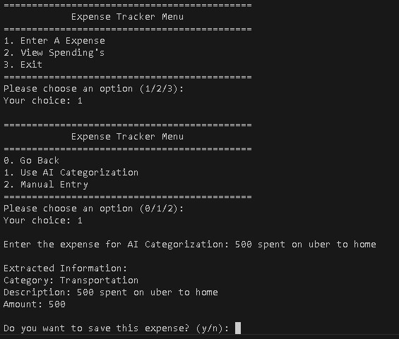
SCREENSHOTS
FIGURE 1: SIGNUP SCREEN
FIGURE 2: EXPENSE ENTRY SCREEN

Slide 11
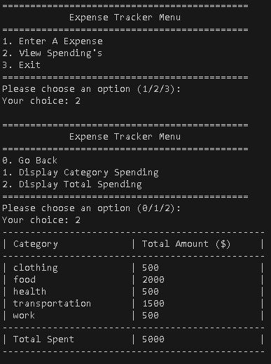
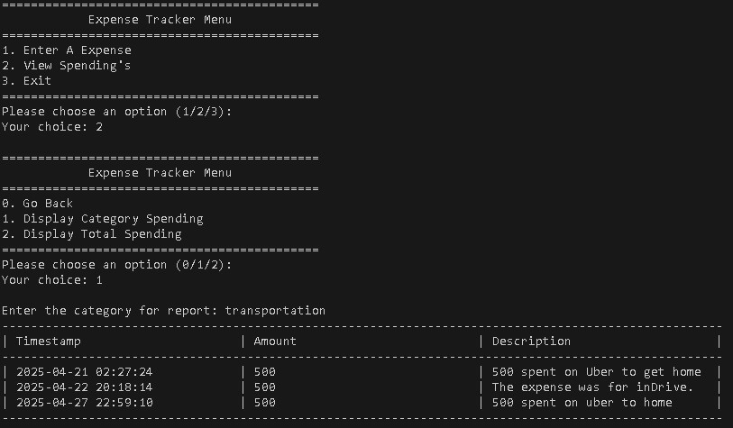
SCREENSHOTS
FIGURE 3: SUMMARY REPORT
FIGURE 4: CATEGORY REPORT

Slide 12
CONCLUSION & FUTURE IMPROVEMENTS
WE SUCCESSFULLY BUILT A SECURE AND SMART EXPENSE TRACKER.
IT REDUCES MANUAL EFFORT AND MAKES BUDGETING EASIER.
IN FUTURE, WE CAN:
○ ADD REAL BANKING APIS.
○ SUPPORT MULTIPLE CURRENCIES.
○ BUILD A MOBILE VERSION.
○ IMPROVE VISUALS WITH PICTORIAL CHARTS AND GRAPHS.

Slide 13

THANK YOU
ANY QUESTIONS?

Slide 14
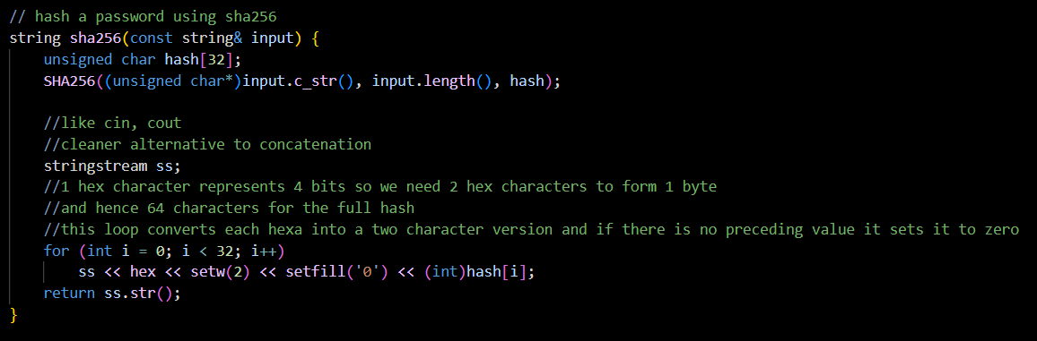
SHA-256 PASSWORD HASHING -> HASHPASSWORD()

Slide 15
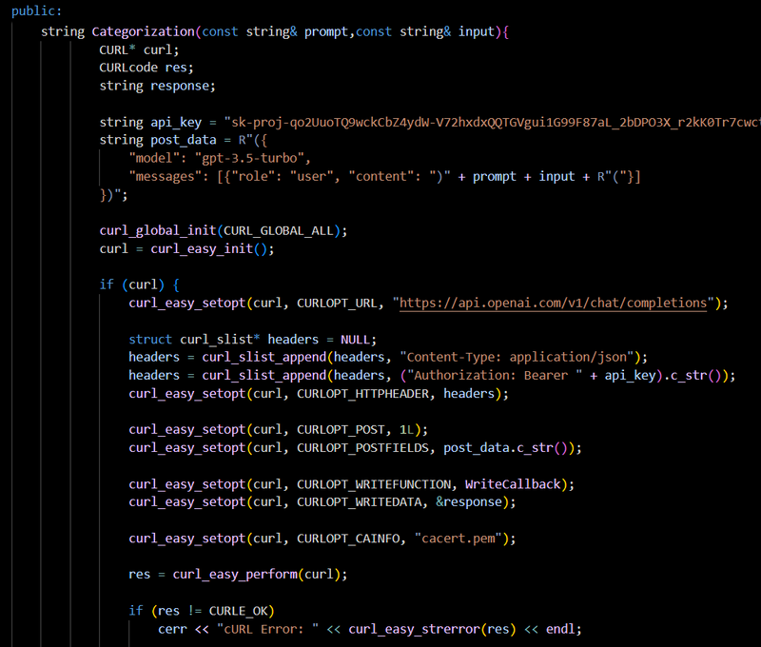
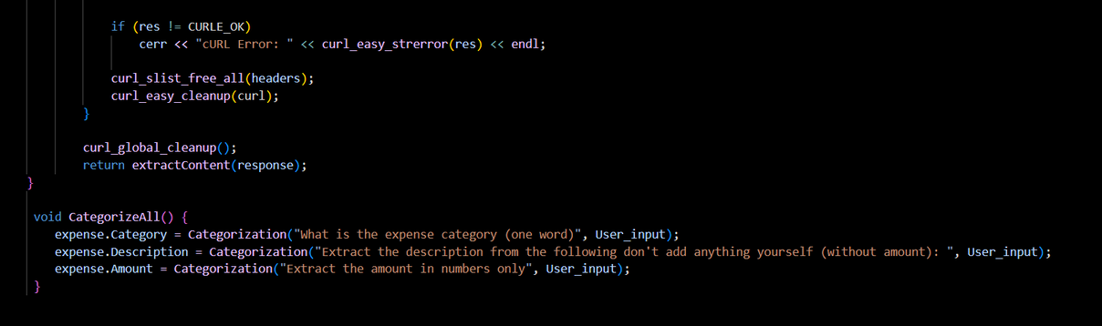
AI CATEGORIZATION FUNCTION -> AI_CATEGORIZATION::CATEGORIZEALL()

